Slide 1

Blockchain-Based Vehicle Registration and Ownership Management System
IN 2900(IT)- Troyrangers
Faculty of Information Technology
University Of Moratuwa
2022

Slide 2





Team Members
Dissanayake DMBM
204047J
Herath PAUD
204074M
Jayathilaka PHP
204087F
Pathirana SPSN
204150TJ
Rathnayaka AMDB
204179N

Slide 3
Table of Content
1
Introduction
7
Proposed Solution
2
Problem in Brief
8
Our Approach
3
Background and Motivation
9
Design
4
Aim
10
Implementation
5
Objectives
11
Evaluation
Further work
6
Existing software
12
DevOps Technologies

Slide 4


Dr. A.L.A.R.R. Thanuja
Department of Computational Mathematics
University of Moratuwa
Supervisor
Mr. H.M.A. Bandara
B.Sc. in Eng (Electrical and Electronic)
M.Sc. in Computer Science
Consultant - Crede Technologies
Mentor

Slide 5

Introduction

Slide 6



Problem in Brief
Security issue in vehicle ownership registration

Slide 7

Background & Motivation
This project is on digitizing real-world objects, specifically vehicles, for the purpose of changing their ownership online.
This has not been done before and requires the development of a new system.

Slide 8

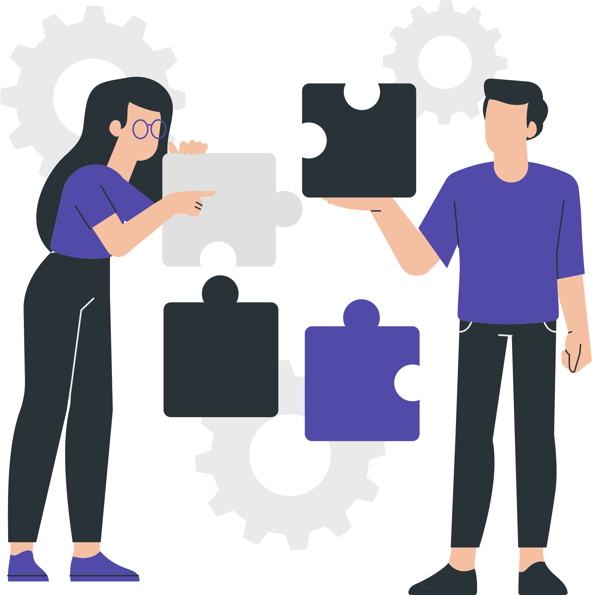
Aim
Develop a system for registering and transferring vehicle ownership from one person to another in a secure manner with the use of Blockchain Technology.

Slide 9

Objectives
To study the problem of the registering and the transferring vehicle ownership from one person to another through document based approach.
To facilitate digitizing the system of registering and transferring vehicle ownership from one person to another.
To create the ability to generate a digital id for verifying person and vehicle identity.
To design the appropriate system including all user requirements.
To develop the system for solving the problem.
Notes:
Let’s move to the objectives of the project,
1. to study the problem.
2. to facilitate digitizing the system.
3. to create the ability to generate a
digital id.
4. to design the appropriate system
including all user requirements.
5. to develop the system for solving the
problem.

Slide 10

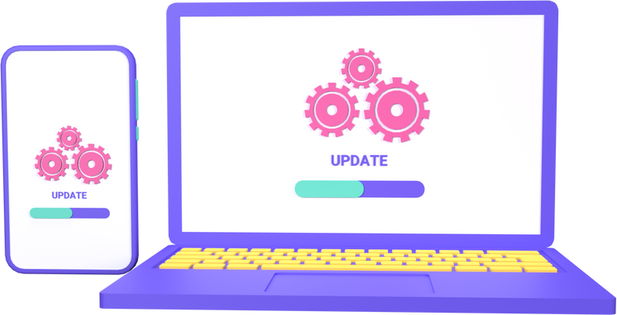
Existing software
Vehicle Registration and Information Management using Blockchain-based Distributed Ledger from Bangladesh Perspective
Sandbox
OpenSea
Notes:
When we talk about the projects and applications which are similar to our system, we were able to find three projects.
The first one is Vehicle Registration and Information Management using Blockchain Based Distributed Ledger from Bangladesh Perspective. It is a proposed system in Bangladesh to replace the existing motor vehicle registration procedure by the Bangladesh Road Transport Authority.
This is only a concept, and this project has not been implemented. And also, NFTs are not used in this project. And also they are created this without any standard.
Sandbox is the second application which we found. In this application they deal with a virtual land. Users can buy and sell Lands via NFTs. The difference between the Sandbox project with ours is that they are selling and buying virtual assets (land) instead of real assets. But in our project, we are dealing with real physical assets.
Third one is the opensea, it is the world's first and largest digital marketplace for crypto collectibles and non-fungible tokens. The difference between this project with our one is that they are selling and buying virtual assets like graphics instead of real assets. But in our project, we are dealing with real physical assets like vehicles.
These are the similarities and differences with our project and above mentioned projects.
Thank you Binari.

Slide 11

Our Approach

Slide 12

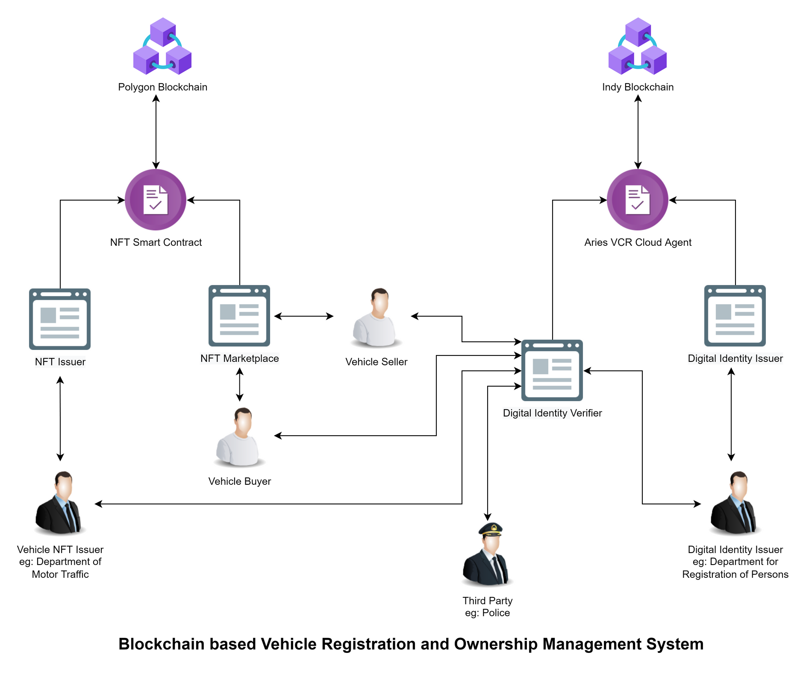
Proposed
Solution
Notes:
Main intention of our proposed solution is to digitize the registration and ownership management system of vehicles.
To do this we are going to implement a system as shown in the diagram. Due to the security is the most important factor; we use blockchain rather than using a centralized database.
The main task of our system is to convert a physical asset into a digital asset. As an example, in our system we convert vehicles into NFTs.
First of all we are creating an NFT when registering the vehicle. Then the NFT issuing officer issues an NFT after handing over the information of vehicle and save it in the polygon blockchain.
In the current situation, we have to identify a person legally on the internet. But there is not a proper way to show a person’s digital identity. Because of that we have to issue a digital verifiable ID for the person. We issue an SSI when a general user hands over their personal information to the SSI issuing officer. The Self sovereign identity that means SSI is saved in Indy blockchain after issuing.
We create a vehicle marketplace to provide the facility of selling and buying vehicles. In this process, transferring the ownership of the vehicle happens through the NFT.
As we can identify the vehicle owner through SSI, we can use SSI to login the digital vehicle marketplace. When login the marketplace, general user have to present their SSI and verify it.
When the lifetime of the vehicle is over, we have to remove the vehicle of use. In that case we can burn-out related NFT. But the information related to that NFT will remain forever with that blockchain.
This is our over all proposed solution.

Slide 13
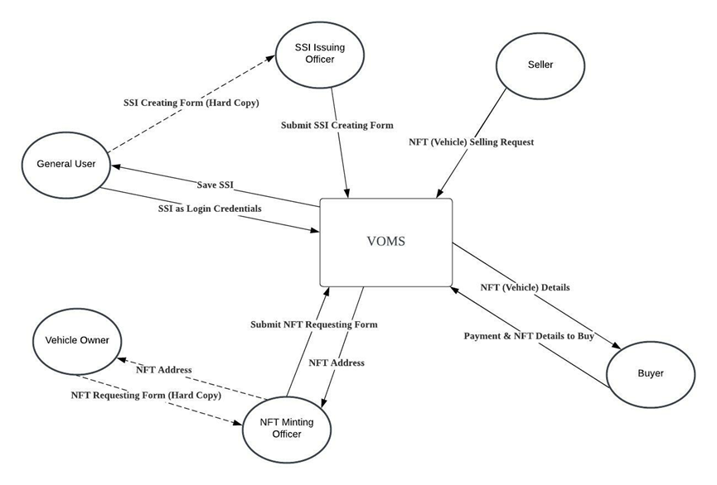
Input Output Diagram

Slide 14

Design
NFT Marketplace
SSI Issuer
SSI Verifier
Mobile SSI Wallet
NFT Minter

Slide 15
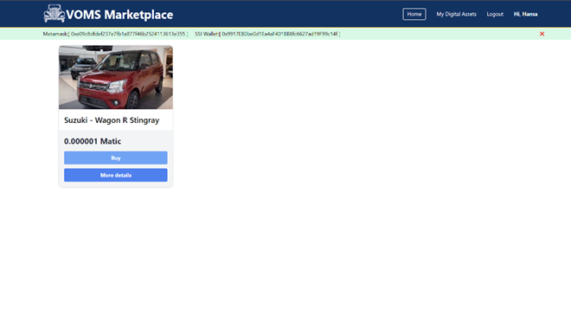
Implementation

Slide 16
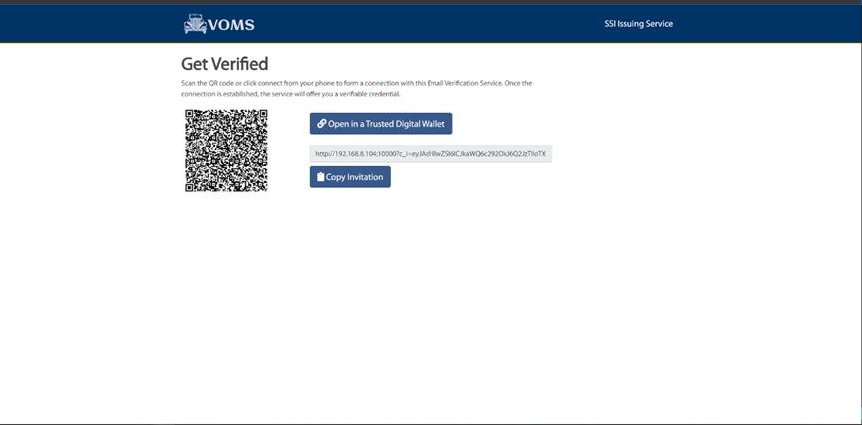

Slide 17
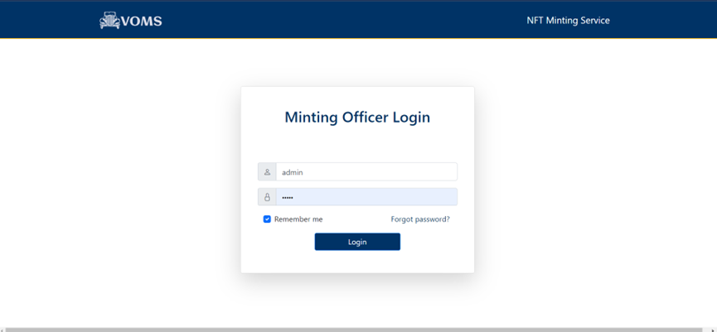

Slide 18
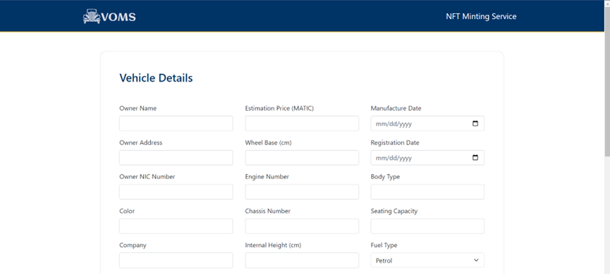

Slide 19
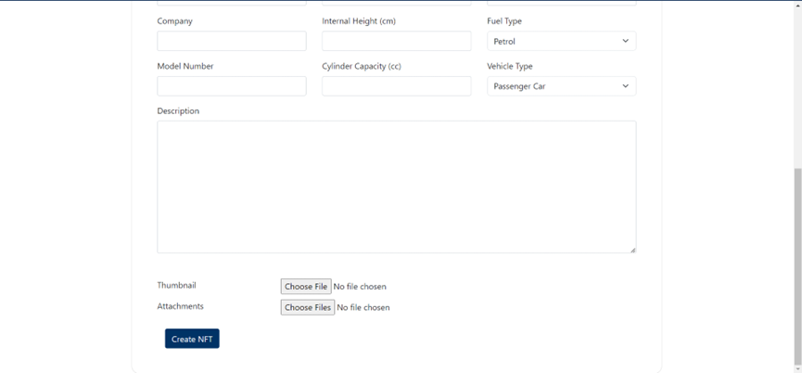

Slide 20
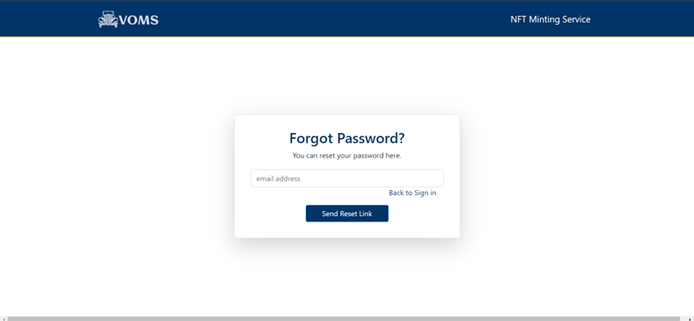

Slide 21
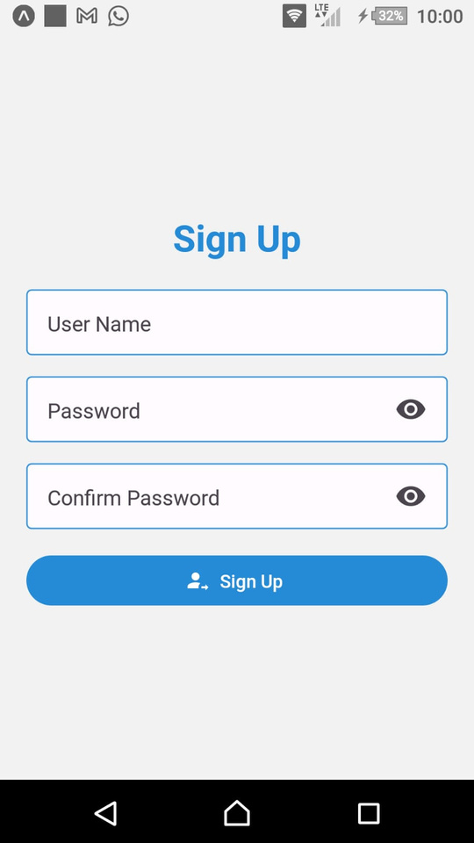
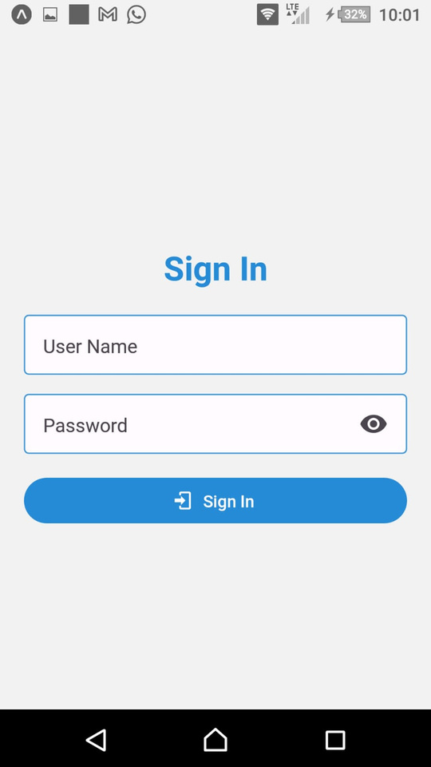
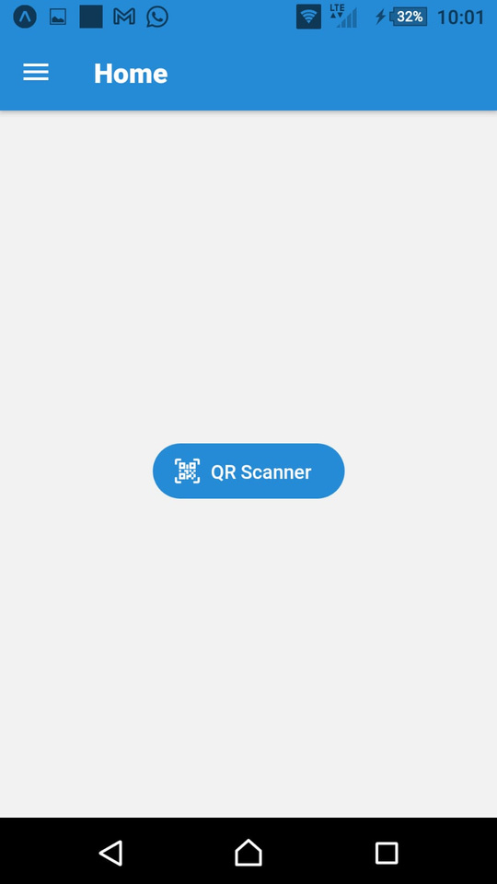

Slide 22
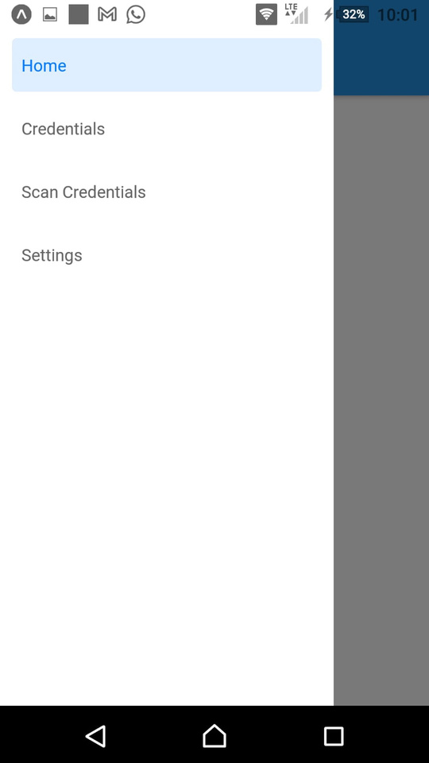
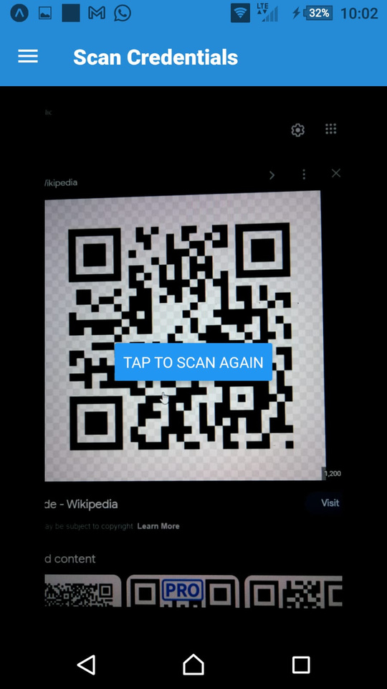

Slide 23
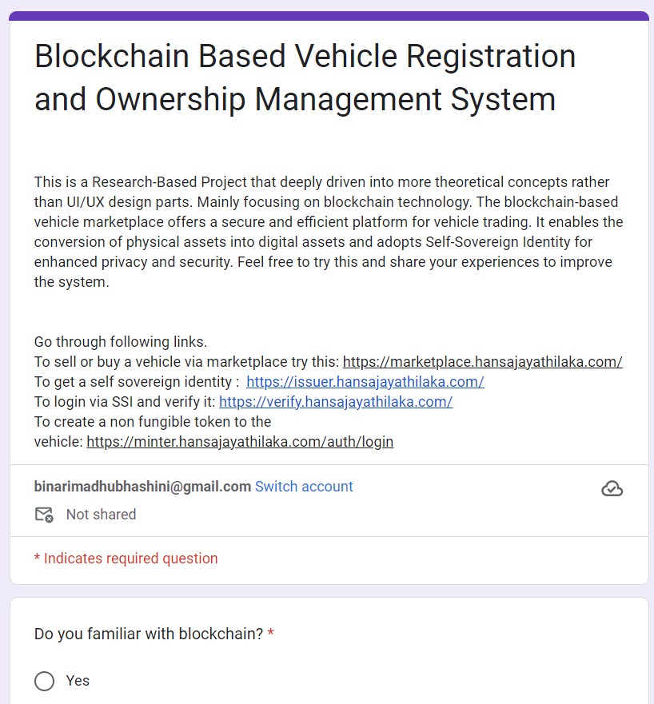
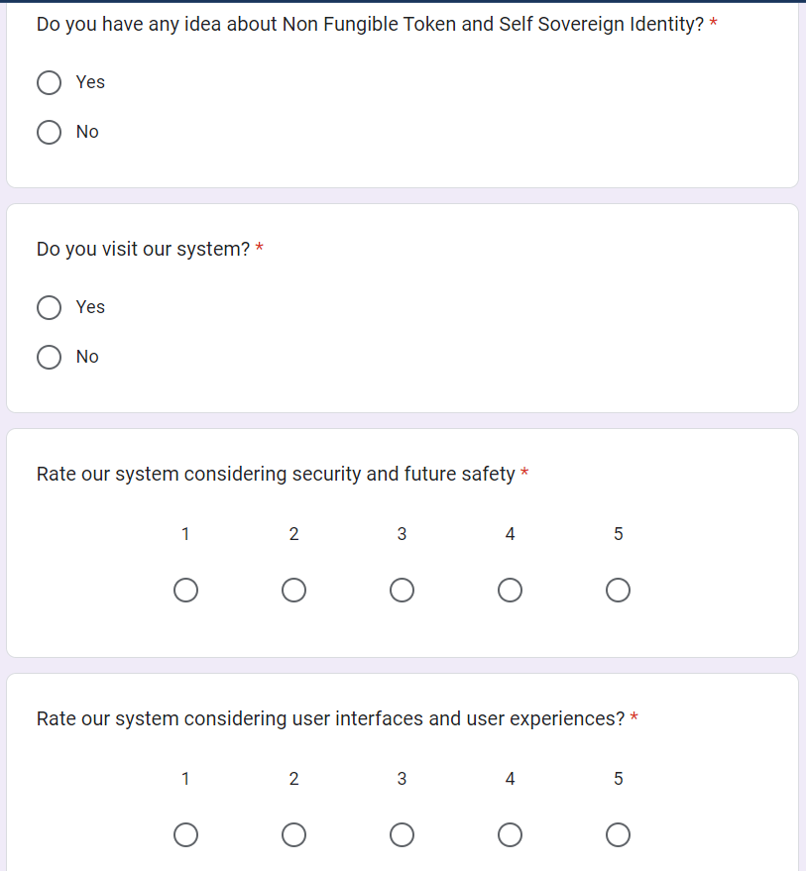
Evaluation

Slide 24
Conclusion
Achievements
The system makes tracking vehicle ownership and transfer efficient, eliminating the error-prone decentralized management solutions.
The non-fungible tokens, vehicles can be uniquely represented on the blockchain, ensure accurate and tamper-proof records.
The system provides a secure platform for storing and verifying essential documents.
By leveraging self-sovereign identity, individuals can authenticate themselves and store their identity information in a mobile wallet.
The system marketplace streamlines the buying and selling of vehicles, facilitating transparent and trustworthy ownership transfers.

Slide 25
Problem Encountered
It is not possible to create a direct link between Indy and polygon blockchains because of that we can not make ultimate authenticate and autherization system. But we are going manage it via a oracle and centralized blockchain client.
Lack of support for indy blockchain

Slide 26


Futther Work
Introduce a new cryptocurrency to do transactions in the marketplace when selling and buying vehicles.
Add a verification with the database maintained by the government with vehicle details parallel to the manual verification process.
Install Kubernets for production.

Slide 27


Individual Contribution

Slide 28

204047J Dissanayake D.M.B.M. - NFT Minter
204074M Herath P.A.U.D. - Mobile Wallet
204087F Jayathilaka P.H.P. - NFT Marketplace
204150T Pathirana S.P.S.N. - SSI Verifier
204179N Rathnayaka A.M.D.B. - SSI Issuer

Slide 29
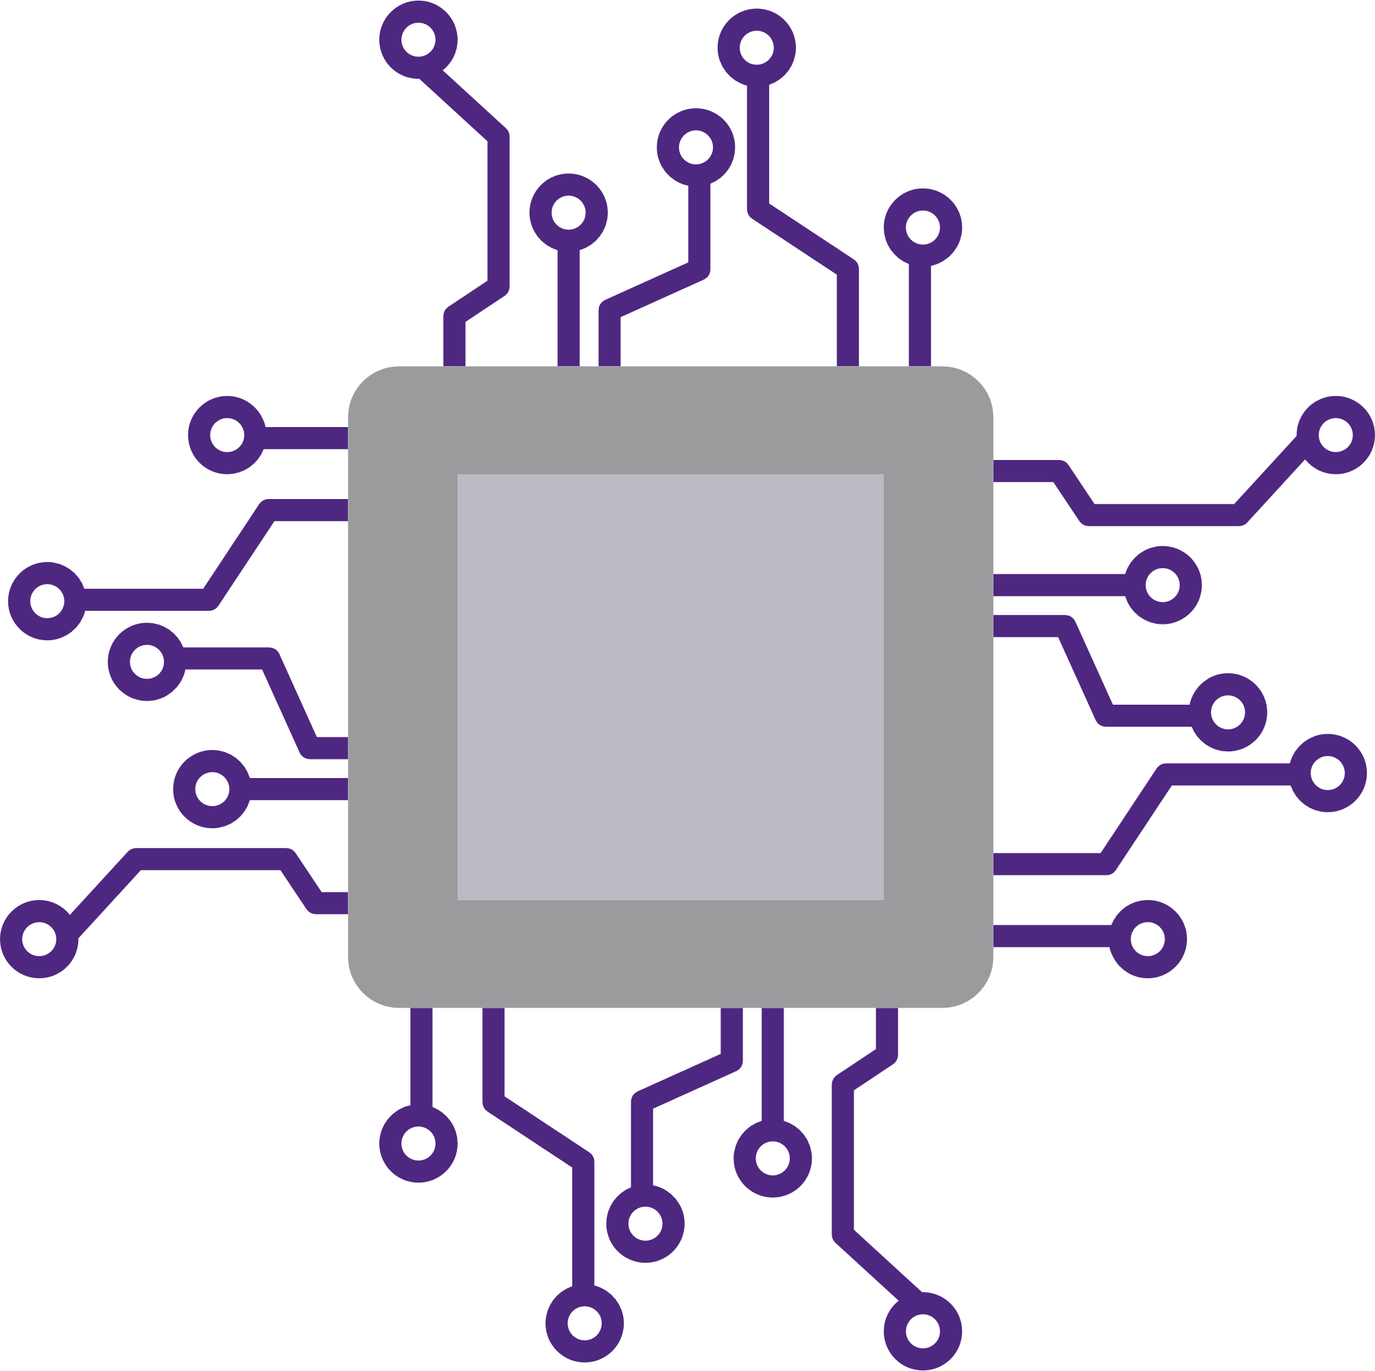
Thank you..

Slide 30
Q & A ?

